Slide 1

History
N 3-4
Year
4
Curriculum Map and Assessment
Framework
Year
1
Year
5
Key Stage 3

Slide 2
EYFS – Understanding the World
N 3-4
Year
4
Development Matters
Nursery
Development Matters Reception
ELG
Past and Present
Use all their senses in hands-on exploration of natural materials.
Explore collections of materials with similar and/or different properties.
Talk about what they see, using a wide vocabulary.
Begin to make sense of their own life-story and family’s history.
Show interest in different occupations.
Explore how things work.
Plant seeds and care for growing plants.
Explore and talk about different forces they can feel.
Talk about members of their immediate family and community.
Name and describe people who are familiar to them.
Comment on images of familiar situations in the past.
Compare and contrast characters from stories, including figures from the past.
Draw information from a simple map.
Understand that some places are special to members of their community.
Explore the natural world around them.
Children at the expected level of development will:-
Talk about the lives of the people around them and their roles in society
Know some similarities and differences between things in the past and now, drawing on their experiences and what has been read in class
Understand the past through settings, characters and events encountered in books read in class and storytelling
Year
1
Year
5
Key Stage 3

Slide 3
EYFS – Milestones for Continuous Provision
N 3-4
Year
4
Children in Nursery will:
Children in Reception will:
Year 1 Ready:
Say who lives in their house
Name their immediate family
Mimic familiar adults engaged in everyday tasks
Talk about roles of the adults they live with
Name and talk about their extended family
Talk freely about family and home life.
Show an interest in occupations linked to transport and farms.
Talk about the occupations of people they live with.
Name and talk about their extended family
Discuss different occupations of family members and people who are known to them.
Ask questions to find out more about different occupations
Talk confidently about the lives of their immediate and extended family, and people who are important to them in their community.
I can recognise that I have changed since I was a baby and discuss some of those changes
I can talk about what I did yesterday/last week
I can order events in my day
I can talk about things that happened a long time ago, a short time ago and today
I can talk about why we remember special historical events
I can talk about people who help us
Year
1
Year
5
Past and Present – Family and Community
Key Stage 3

Slide 4
EYFS – Milestones for Continuous Provision
N 3-4
Year
4
Children in Nursery will:
Children in Reception will:
Year 1 Ready:
Talk about how they have changed from being a baby.
Say how children and adults are different.
Recall special times, such as birthdays they remember in their life
Comment on historical characters they see in books.
Distinguish between past and present when looking at photographs, objects and books. • Compare characters in book, including those from past.
Talk about similarities and difference between past and present when looking at photographs of their locality. Compare characters, places and objects from the past, sharing similarities and differences that they notice
I can recognise that I have changed since I was a baby and discuss some of those changes
I can talk about what I did yesterday/last week
I can order events in my day
I can talk about things that happened a long time ago, a short time ago and today
I can talk about why we remember special historical events
I can talk about people who help us
Year
1
Year
5
Past and Present – Changes and Historical Importance
Key Stage 3

Slide 5
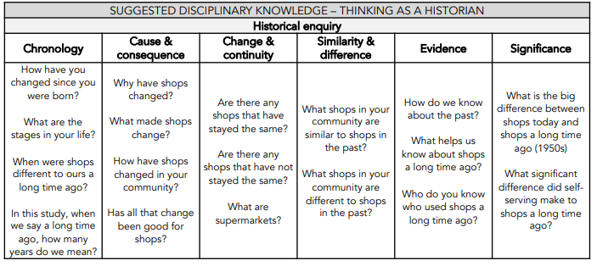
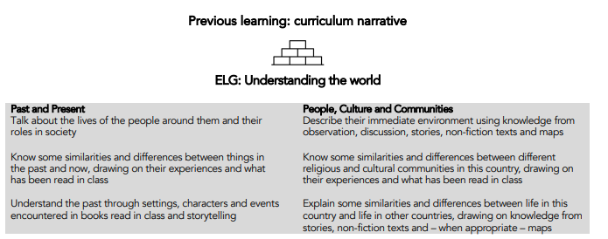
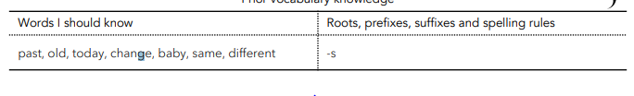
Key Stage 1 – Year 1
N 3-4
Term | NC objectives | The Big Idea Substantive Concepts | How will I think and act like a Historian | Pupil Outcomes Historical knowledge and understanding
Year 1 Autumn Term | Changes within living memory. Where appropriate, these should be used to reveal aspects of change in national life | Changes within living memory – What is it like around here? Community Knowledge |  | I can describe what my local community is like I can name the shops in my local community: supermarket, bakery, I can talk about what shops were like in the past I can discus how shops have changed over time I can compare shops today to shops a long-time age
Curriculum Narrative and Previous Learning
Year
4
Year
1
Year
5
Key Stage 3

Slide 6
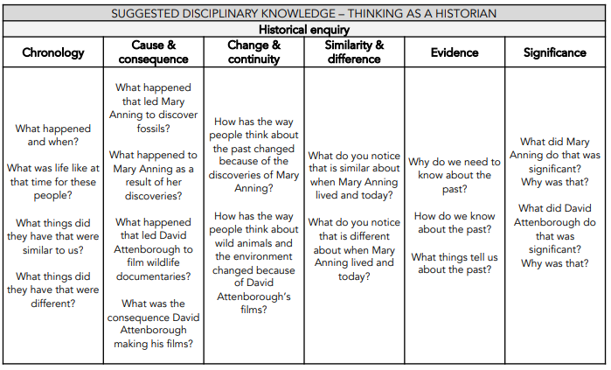
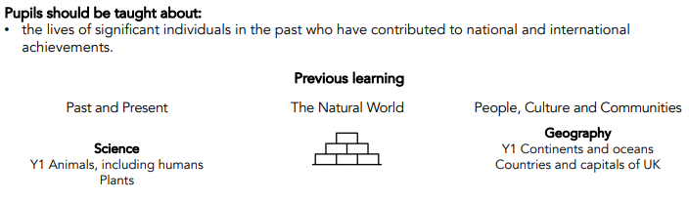
Key Stage 1 – Year 1
Term | NC objectives | The Big Idea Substantive Concepts | How will I think and act like a Historian | Pupil Outcomes Historical knowledge and understanding
Year 1 Spring Term | The lives of significant individuals in the past who have contributed to national and international achievements. | Study the lives of significant individuals in the past – Mary Anning and David Attenborough Community Knowledge |  | I can say who Mary Anning is and what she is known for. I can name the discoveries Mary Anning made. I can say who David Attenborough is and what he is known for. I can explain what David Attenborough has achieved. I can make comparisons between Mary Anning and David Attenborough, considering the similarities and differences.
Curriculum Narrative and Previous Learning
N 3-4
Year
4
Year
1
Year
5
Key Stage 3

Slide 7
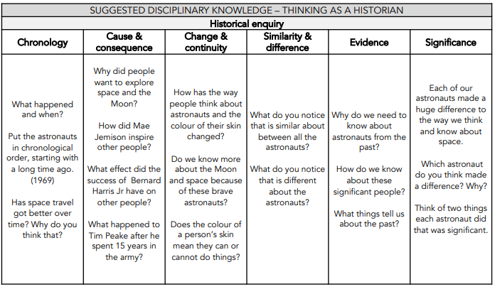
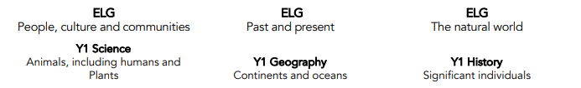
Key Stage 1 – Year 1
Term | NC objectives | The Big Idea Substantive Concepts | How will I think and act like a Historian | Pupil Outcomes Historical knowledge and understanding
Year 1 Summer Term | The lives of significant individuals in the past who have contributed to national and international achievements | More lives of significant people - Neil Armstrong, Mae Jemison, Bernard Harris Jr, Tim Peake. Community Knowledge |  | I can say who Neil Armstrong is and what he is known for (first person to land on the moon). I can name at least one other astronaut from those studied (Mae Jemison, Bernard Harris Jr or Team Peake), and say what they are known for. I can make comparisons between Neil Armstrong and one other astronaut studied, considering the similarities and differences.
Curriculum Narrative and Previous Learning
N 3-4
Year
4
Year
1
Year
5
Key Stage 3

Slide 8
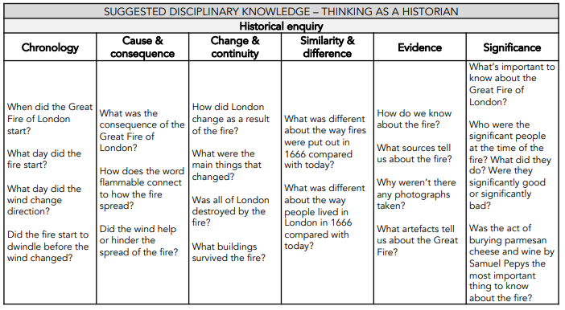
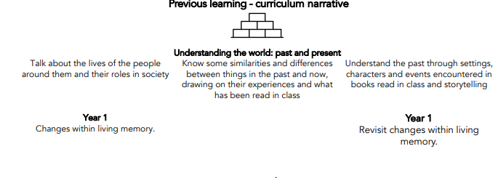

Key Stage 1 – Year 2
Term | NC objectives | The Big Idea Substantive Concepts | How will I think and act like a Historian | Pupil Outcomes Historical knowledge and understanding
Year 2 Autumn Term | Events beyond living memory that are significant nationally or globally [for example, the Great Fire of London, the first aeroplane flight or events commemorated through festivals or anniversaries] | Events beyond living memory – The Great Fire of London Community Knowledge Power Democracy |  | I can state when and where the Great Fire of London occurred. I can say how the Great Fire of London started. I can give reasons why the Great Fire of London spread quickly. I can name places including monuments that the fire spread to. I can explain how we know about the events of the Great Fire of London. I can explain the effect the Great Fire of London had on London and discuss how London changed as a result.
Curriculum Narrative and Previous Learning
N 3-4
Year
4
Year
1
Year
5
Key Stage 3

Slide 9
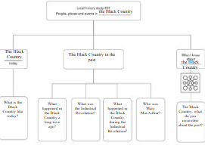

Key Stage 1 – Year 2
Term | NC objectives | The Big Idea Substantive Concepts | How will I think and act like a Historian | Pupil Outcomes Historical knowledge and understanding
Year 2 Spring Term | significant historical events, people and places in their own locality. | History of the Black Country through time. Knowledge Community |  | I can name the boroughs that make up the Black Country – Sandwell, Dudley, Wolverhampton and Walsall I know that Dudley Castle was built in 1070, rich family lived in the castle and protected the local people I now that over 1000 years ago people lived on farms I know what the industrial revolution was and that it happened between 1750-1900 I know that Cradley Heath made chains and Stourbridge made glass
Curriculum Narrative and Previous Learning
N 3-4
Year
4
Year
1
Year
5
Key Stage 3

Slide 10

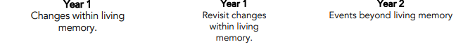
Key Stage 1 – Year 2
Term | NC objectives | The Big Idea Substantive Concepts | How will I think and act like a Historian | Pupil Outcomes Historical knowledge and understanding
Year 2 Summer Term | Events beyond living memory that are significant nationally or globally | REVISIT Events beyond living memory The Great Fire of London Community Knowledge Power Democracy |  | I can state when and where the Great Fire of London occurred. I can say how the Great Fire of London. I can give reasons why the Great Fire of London spread quickly. I can name places including monuments that the fire spread to. I can explain how we know about the events of the Great Fire of London. I can explain the effect the Great Fire of London had on London and discuss how London changed as a result.
Curriculum Narrative and Previous Learning
N 3-4
Year
4
Year
1
Year
5
Key Stage 3

Slide 11
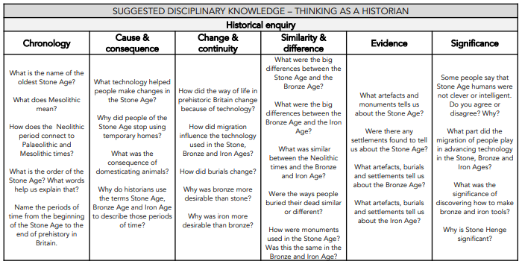
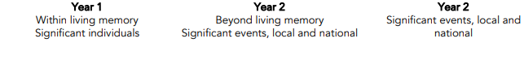

Key Stage 2 – Year 3
Term | NC objectives | The Big Idea Substantive Concepts | How will I think and act like a Historian | Pupil Outcomes Historical knowledge and understanding
Year 3 Autumn and Spring Term | changes in Britain from the Stone Age to the Iron Age | Stone age – Iron Age Community Knowledge Power |  | I can name the three periods of the Stone Age and that it was known as the Stone Age as stones were used as tools. I can say how the three periods of the Stone Age were different. I can say that the Stone Age was followed by the Bronze Age and that bronze was used for tools and other items. I can say that the Bronze Age was followed by the Iron Age and that iron was used for tools and other items. I can compare the Stone Age, Bronze Age and Iron Age, suggesting how we know about the changes. I can order the three ages studied on a time line.
Curriculum Narrative and Previous Learning
N 3-4
Year
4
Year
1
Year
5
Key Stage 3

Slide 12
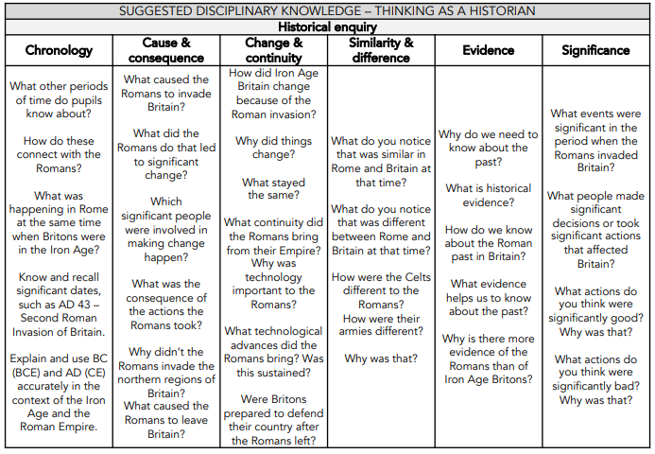
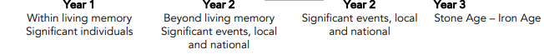

Key Stage 2 – Year 3
Term | NC objectives | The Big Idea Substantive Concepts | How will I think and act like a Historian | Pupil Outcomes Historical knowledge and understanding
Year 3 Spring and Summer Term | The Roman Empire and its impact on Britain | Stone age – Iron Age Continued from Autumn Term (see above) Rome and the impact of Britain Invasion Power Civilisation |  | I can say that the Romans were an ancient civilisation who conquered other people and countries and built a large, powerful empire. I can say what it was like to live in Rome. I can make links to the Iron Age and what life was like prior to the Roman Invasions. I can recognise that there were two separate invasions of Britain by the Romans. I can give an example of Roman resistance. I can explain how Britain changed as a result of Roman rule considering technology and beliefs. I can explain the impact of the Roman Empire on Britain
Curriculum Narrative and Previous Learning
N 3-4
Year
4
Year
1
Year
5
Key Stage 3

Slide 13
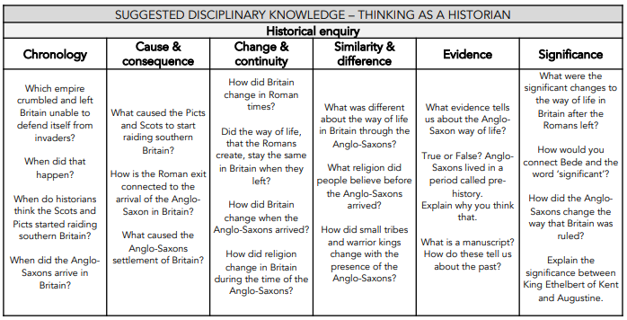
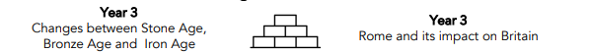

Key Stage 2 – Year 4
Term | NC objectives | The Big Idea Substantive Concepts | How will I think and act like a Historian | Pupil Outcomes Historical knowledge and understanding
Year 4 Autumn Term | Britain’s settlement by Anglo-Saxons and Scots | Anglo-Saxons Invasion Power Community |  | I can explain why the Anglo-Saxons came to Britain. I can identify where the Anglo-Saxons came from and how they got there. I can explain what life was like for the Anglo-Saxons who settled in Britain. I can identify what kingdoms were formed by the Anglo-Saxons. I can identify the Anglo-Saxon kingdoms on a map of Britain. I can show an understanding of Anglo-Saxon artefacts, heritage sites and place names and explain why they are important in developing an understanding of the past. I can explain how religion influenced the Anglo-Saxons and show how we know this today.
Curriculum Narrative and Previous Learning
N 3-4
Year
4
Year
1
Year
5
Key Stage 3

Slide 14
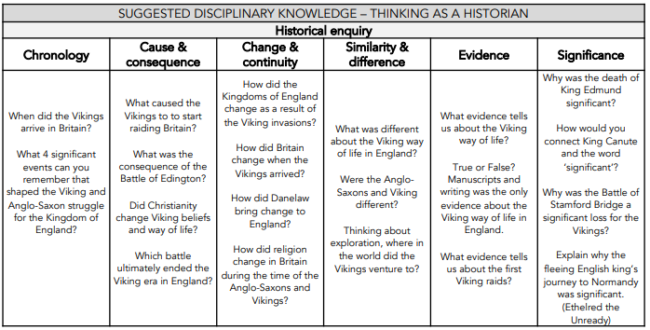
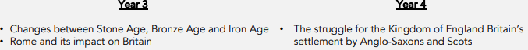

Key Stage 2 – Year 4
Term | NC objectives | The Big Idea Substantive Concepts | How will I think and act like a Historian | Pupil Outcomes Historical knowledge and understanding
Year 4 Spring Term | the Viking and Anglo-Saxon struggle for the Kingdom of England to the time of Edward the Confessor | Vikings Invasion Power Community |  | I can describe what life was like for Vikings I can explain when, why and how the Vikings attacked Britain I can explain where the Vikings attacked Britain and where they settled I can ex0lain why the Vikings were so feared and successful I can describe when and why the Vikings were most successful I can explain the peace that was agreed between the Anglo-Saxons and the Vikings I can explain what happened to the Vikings in England in AD954 I can explain why the Normans and the Vikings both thought they had the right to the throne of England
Curriculum Narrative and Previous Learning
N 3-4
Year
4
Year
1
Year
5
Key Stage 3

Slide 15
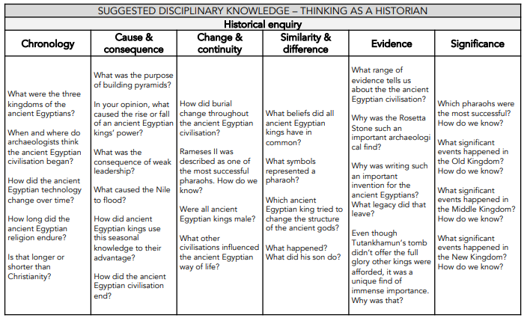

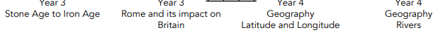
Key Stage 2 – Year 4
Term | NC objectives | The Big Idea Substantive Concepts | How will I think and act like a Historian | Pupil Outcomes Historical knowledge and understanding
Year 4 Summer Term | The achievements of the earliest civilizations – an overview of where and when the first civilizations appeared and a depth study of one of the following: Ancient Sumer; The Indus Valley; Ancient Egypt; The Shang Dynasty of Ancient China | Ancient civilisation – Egypt Invasion Power Civilisation Knowledge |  | I can identify some of the early civilisations and explain what they achieved. I can explain who the ancient Egyptians were. I can locate where the ancient Egyptians lived. I can understand and explain what ‘The Old Kingdom’ was and what it achieved. I can understand and explain what ‘The Middle Kingdom’ was and what it achieved. I can understand and explain what ‘The New Kingdom’ was and what it achieved. I can identify how the ancient Egyptians wrote and explain what they wrote about. I can identify and explain how the ancient Egyptians used the River Nile. I can explain the effect and advantages of using the River Nile in this way. I can explain who the ancient Egyptian Gods were and what the ancient Egyptians practiced and believed. I can demonstrate an understanding of Tutankhamun by explaining who he was and why he was important.
Curriculum Narrative and Previous Learning
N 3-4
Year
4
Year
1
Year
5
Key Stage 3

Slide 16
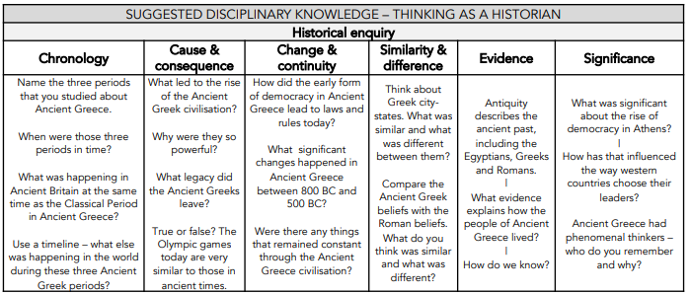
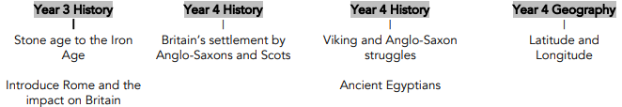

Key Stage 2 – Year 5
Term | NC objectives | The Big Idea Substantive Concepts | How will I think and act like a Historian | Pupil Outcomes Historical knowledge and understanding
Year 5 Autumn and Spring Term | Ancient Greece – a study of Greek life and achievements and their influence on the western world | Ancient Greeks - a study of Greek life and achievements and their influence on the western world Democracy Power Civilisation Knowledge |  | I can understand who the Ancient Greeks were. I can identify when the Ancient Greeks ruled and the different periods during this time. I can identify and explain the beliefs of the Ancient Greeks. I can identify the city-states of Athens and Sparta. I can explain the differences between Athens and Sparta. I can demonstrate an understanding of Athens and its democracy explaining how it was governed. I can explain why the theatre was important to the Ancient Greeks. I can explain what myths and fables the Ancient Greeks wrote. I can explain what happened during the Battle of Salamis and why it was important. I can explain why the Olympic games were invented by the Ancient Greeks. I can explain who Alexander the Great was and why he was so renowned
Curriculum Narrative and Previous Learning
N 3-4
Year
4
Year
1
Year
5
Key Stage 3

Slide 17
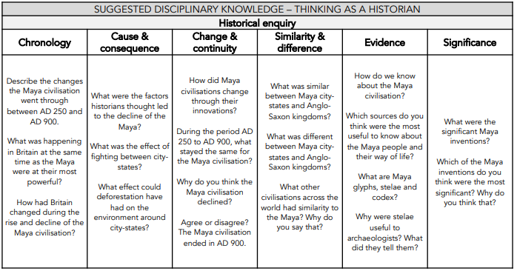


Key Stage 2 – Year 5
Term | NC objectives | The Big Idea Substantive Concepts | How will I think and act like a Historian | Pupil Outcomes Historical knowledge and understanding
Year 5 Spring and Summer Term | Britain’s settlement by Anglo-Saxons and Scots the Viking and Anglo-Saxon struggle for the Kingdom of England to the time of Edward the Confessor a non-European society that provides contrasts with British history | Comparison study – Maya and Anglo-Saxons. Civilisation Knowledge Power |  | I can locate where the Maya lived. I can demonstrate an understanding of the climate in which the Maya lived. I can identify and explain key events in the Maya history. I can demonstrate an understanding of factors which effected the Maya population. I can identify key structures within a Maya city. I can explain the significance of Maya city structures. I can identify some of the Maya inventions. I can explain why some Maya inventions were important or significant. I can explain what potential factors caused the decline of the Maya city-states. I can recall and retrieve information about Britain and the Anglo-Saxons. I can compare and contrast the lives of the Maya and Anglo-Saxons.
Curriculum Narrative and Previous Learning
N 3-4
Year
4
Year
1
Year
5
Key Stage 3

Slide 18
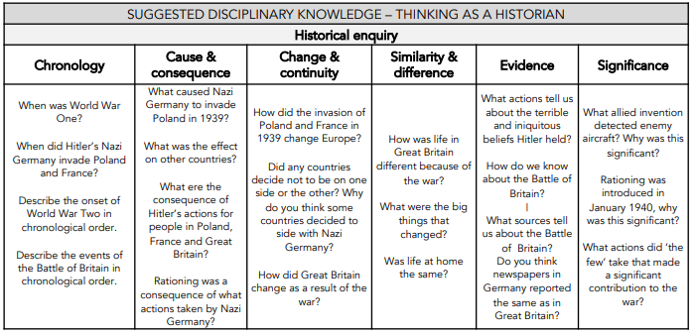
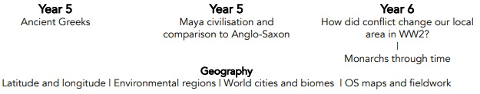

Key Stage 2 – Year 6
Term | NC objectives | The Big Idea Substantive Concepts | How will I think and act like a Historian | Pupil Outcomes Historical knowledge and understanding
Year 6 Autumn Term | Pupils should be taught about: A study of an aspect or theme in British history that extends pupils’ chronological knowledge beyond 1066. | Battle of Britain Power Invasion Community |  | I can explain why did Britain declared war on Germany in 1939 I can explain why rationing was introduced I can explain why people were evacuated from cities I can describe the events and timelines of the Battle of Britain. I can describe he Blitz and how Hitler continued to attack Britain I can explain how conflict changed society in the Second World War.
Curriculum Narrative and Previous Learning
N 3-4
Year
4
Year
1
Year
5
Key Stage 3

Slide 19
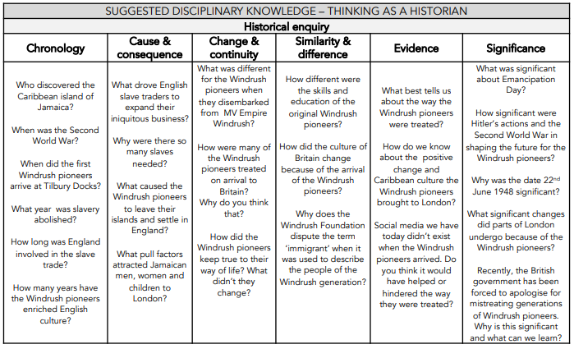
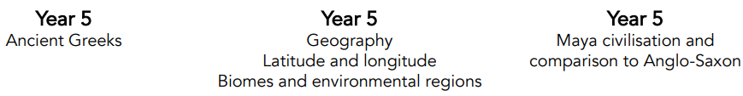

Key Stage 2 – Year 6
Term | NC objectives | The Big Idea Substantive Concepts | How will I think and act like a Historian | Pupil Outcomes Historical knowledge and understanding
Year 6 Spring Term | a study of an aspect or theme in British history that extends pupils’ chronological knowledge beyond 1066 | Windrush Generation Community Democracy Power |  | I can locate the Caribbean islands and explain their history. I can explain how the people of the Caribbean helped Britain in the war against Nazi Germany and Hitler. I can discuss the migration of people from the Caribbean to Britain in 1948. I can explain what life was like for the Windrush pioneers. I can say who Sam King is and what he is known for. I can say who Norma Best is and what she is known for. I can explain how the Windrush migration changed Britain.
Curriculum Narrative and Previous Learning
N 3-4
Year
4
Year
1
Year
5
Key Stage 3

Slide 20
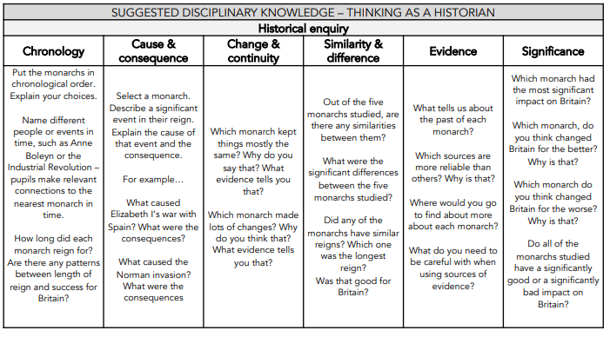
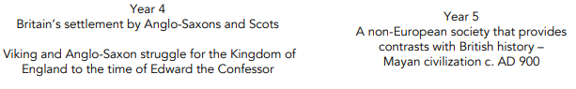

Key Stage 2 – Year 6
Term | NC objectives | The Big Idea Substantive Concepts | How will I think and act like a Historian | Pupil Outcomes Historical knowledge and understanding
Year 6 Summer Term | A study of an aspect or theme in British history that extends pupils’ chronological knowledge beyond 1066 the changing power of monarchs using case studies such as John, Anne and Victoria | Beyond 1066 - Study 5 Monarchs Through Time Power Invasion democracy |  | I can name five key monarchs. I can say how William I is remembered. I can say how Henry VIII is remembered. I can say how Elizabeth I is remembered. I can say how Charles II is remembered. I can say how Queen Victoria is remembered. I can use what I know about the five monarchs studied to suggest who was the greatest monarch, using historical evidence and context to support my answer.
Curriculum Narrative and Previous Learning
N 3-4
Year
4
Year
1
Year
5
Key Stage 3

